Slide 1
H-1B Petition Analysis
& Job Hunting Recommendations
--for international job seekers
Rong Liao
Shan Lin
Shenyang Yang
Jingda Zhou
Notes:
1. Credibility
2. Introduce H1b visa & Why Care
3. Attention getter: the story

Slide 2
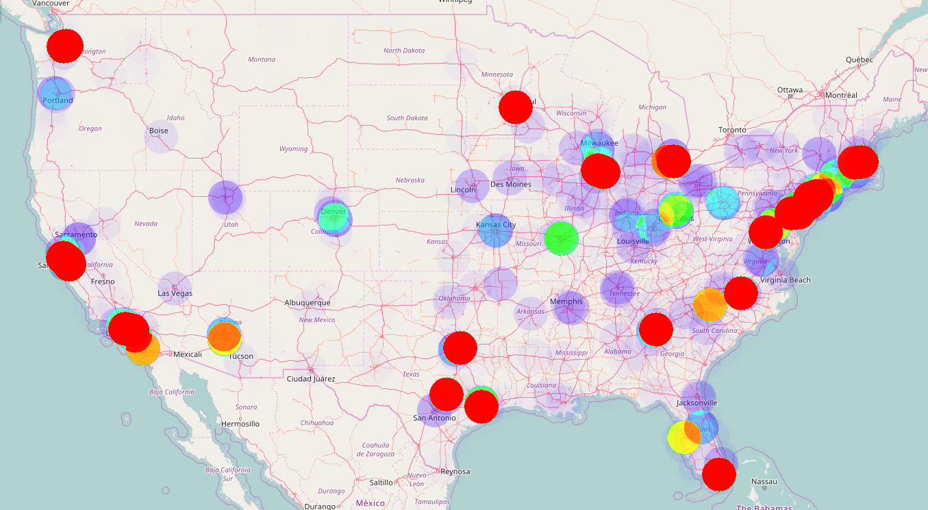
H-1B seekers, we know it’s hard!
H-1B sponsor opportunity distribution
Location
Salary
Employer
Industry
Notes:
-Thesis Statement:
Time is limited. We need to know which locations, industries, and job functions have most opportunities, and focus on them.
-Main Points: Major analyses, results, data interpretation recommendation
-Conclusion and final thoughts
We need to narrow down the scope

Slide 3
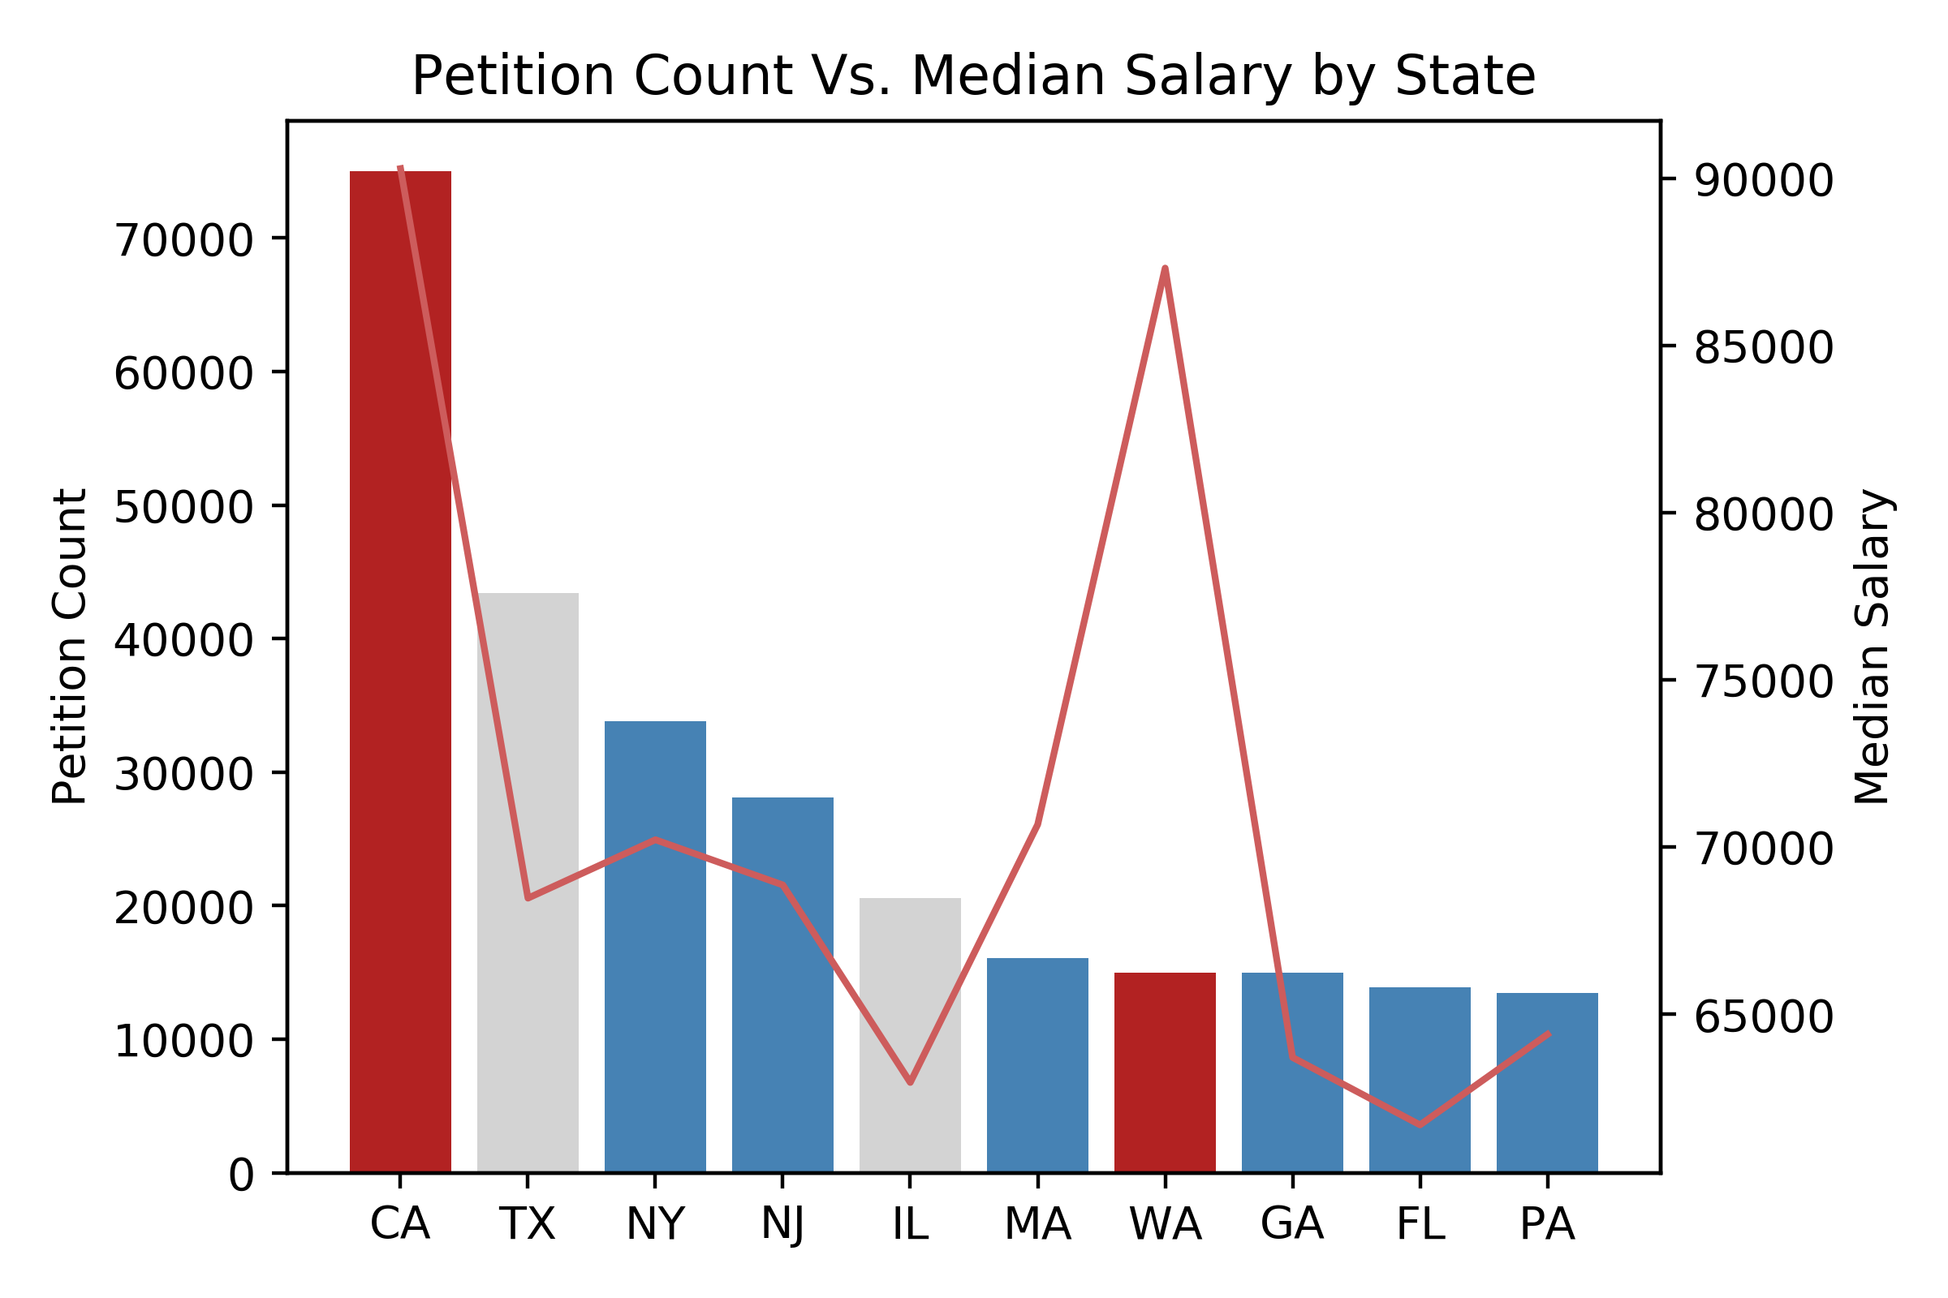
Coastal areas have more opportunities
West coast
higher salary
East coast
diverse locations
Notes:
West coast: CA and WA (~ 90000USD
East coast:
Exceptions: IL and TX

Slide 4
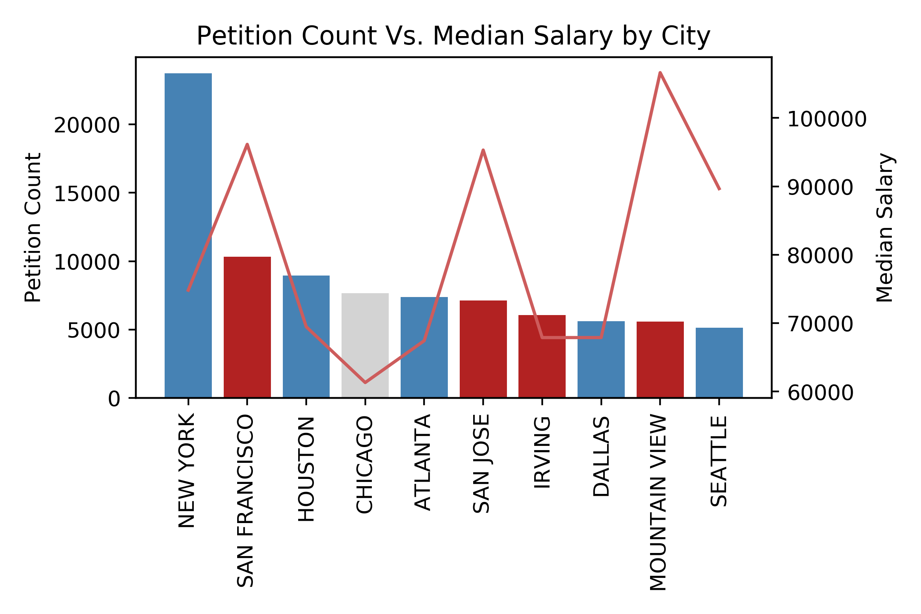
California has higher salary
4 out of 10
San Francisco,
San Jose,
Mountainview: $90000USD
Notes:
Location 2: City plot-
California has most opportunities, higher pay & beaches and surfing
Seattle, NY comes after

Slide 5
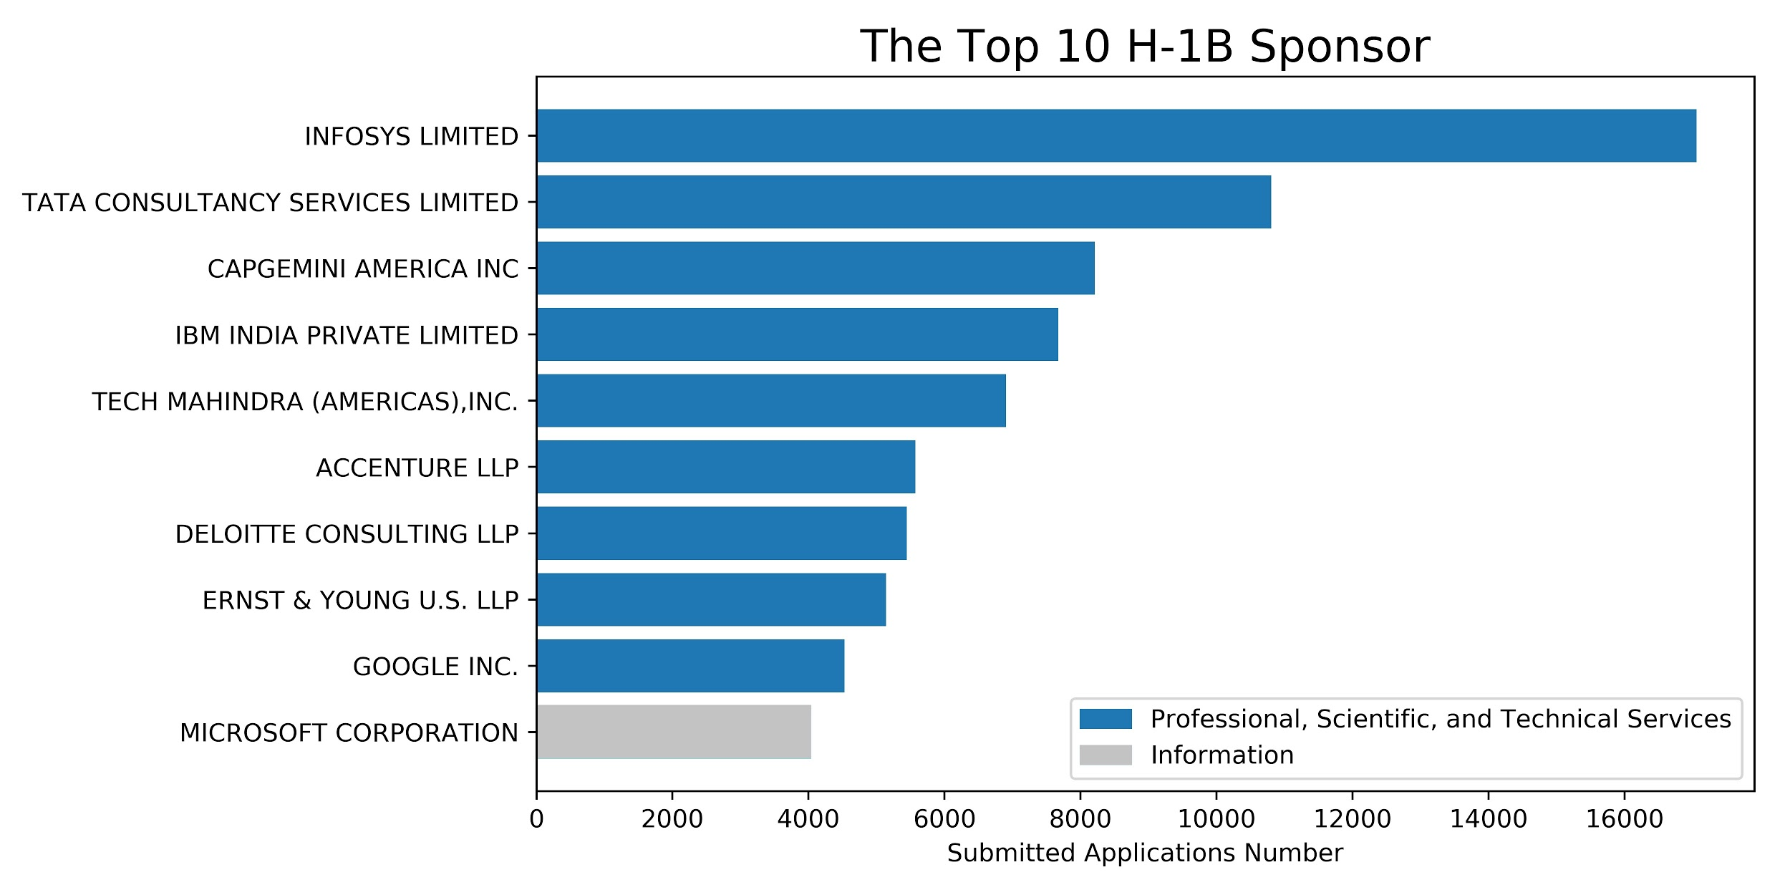
Top 10 H-1B sponsors require high expertise
Notes:
The Professional, Scientific, and Technical Services sector comprises establishments that specialize in performing professional, scientific, and technical activities for others. These activities require a high degree of expertise and training. The establishments in this sector specialize according to expertise and provide these services to clients in a variety of industries and, in some cases, to households.
Legal Services: NAICS 5411
Accounting, Tax Preparation, Bookkeeping, and Payroll Services: NAICS 5412
Architectural, Engineering, and Related Services: NAICS 5413
Specialized Design Services: NAICS 5414
Computer Systems Design and Related Services: NAICS 5415
Management, Scientific, and Technical Consulting Services: NAICS 5416
Scientific Research and Development Services: NAICS 5417
Advertising and Related Services: NAICS 5418
Other Professional, Scientific, and Technical Services: NAICS 5419
Infosys: consultancy

Slide 6
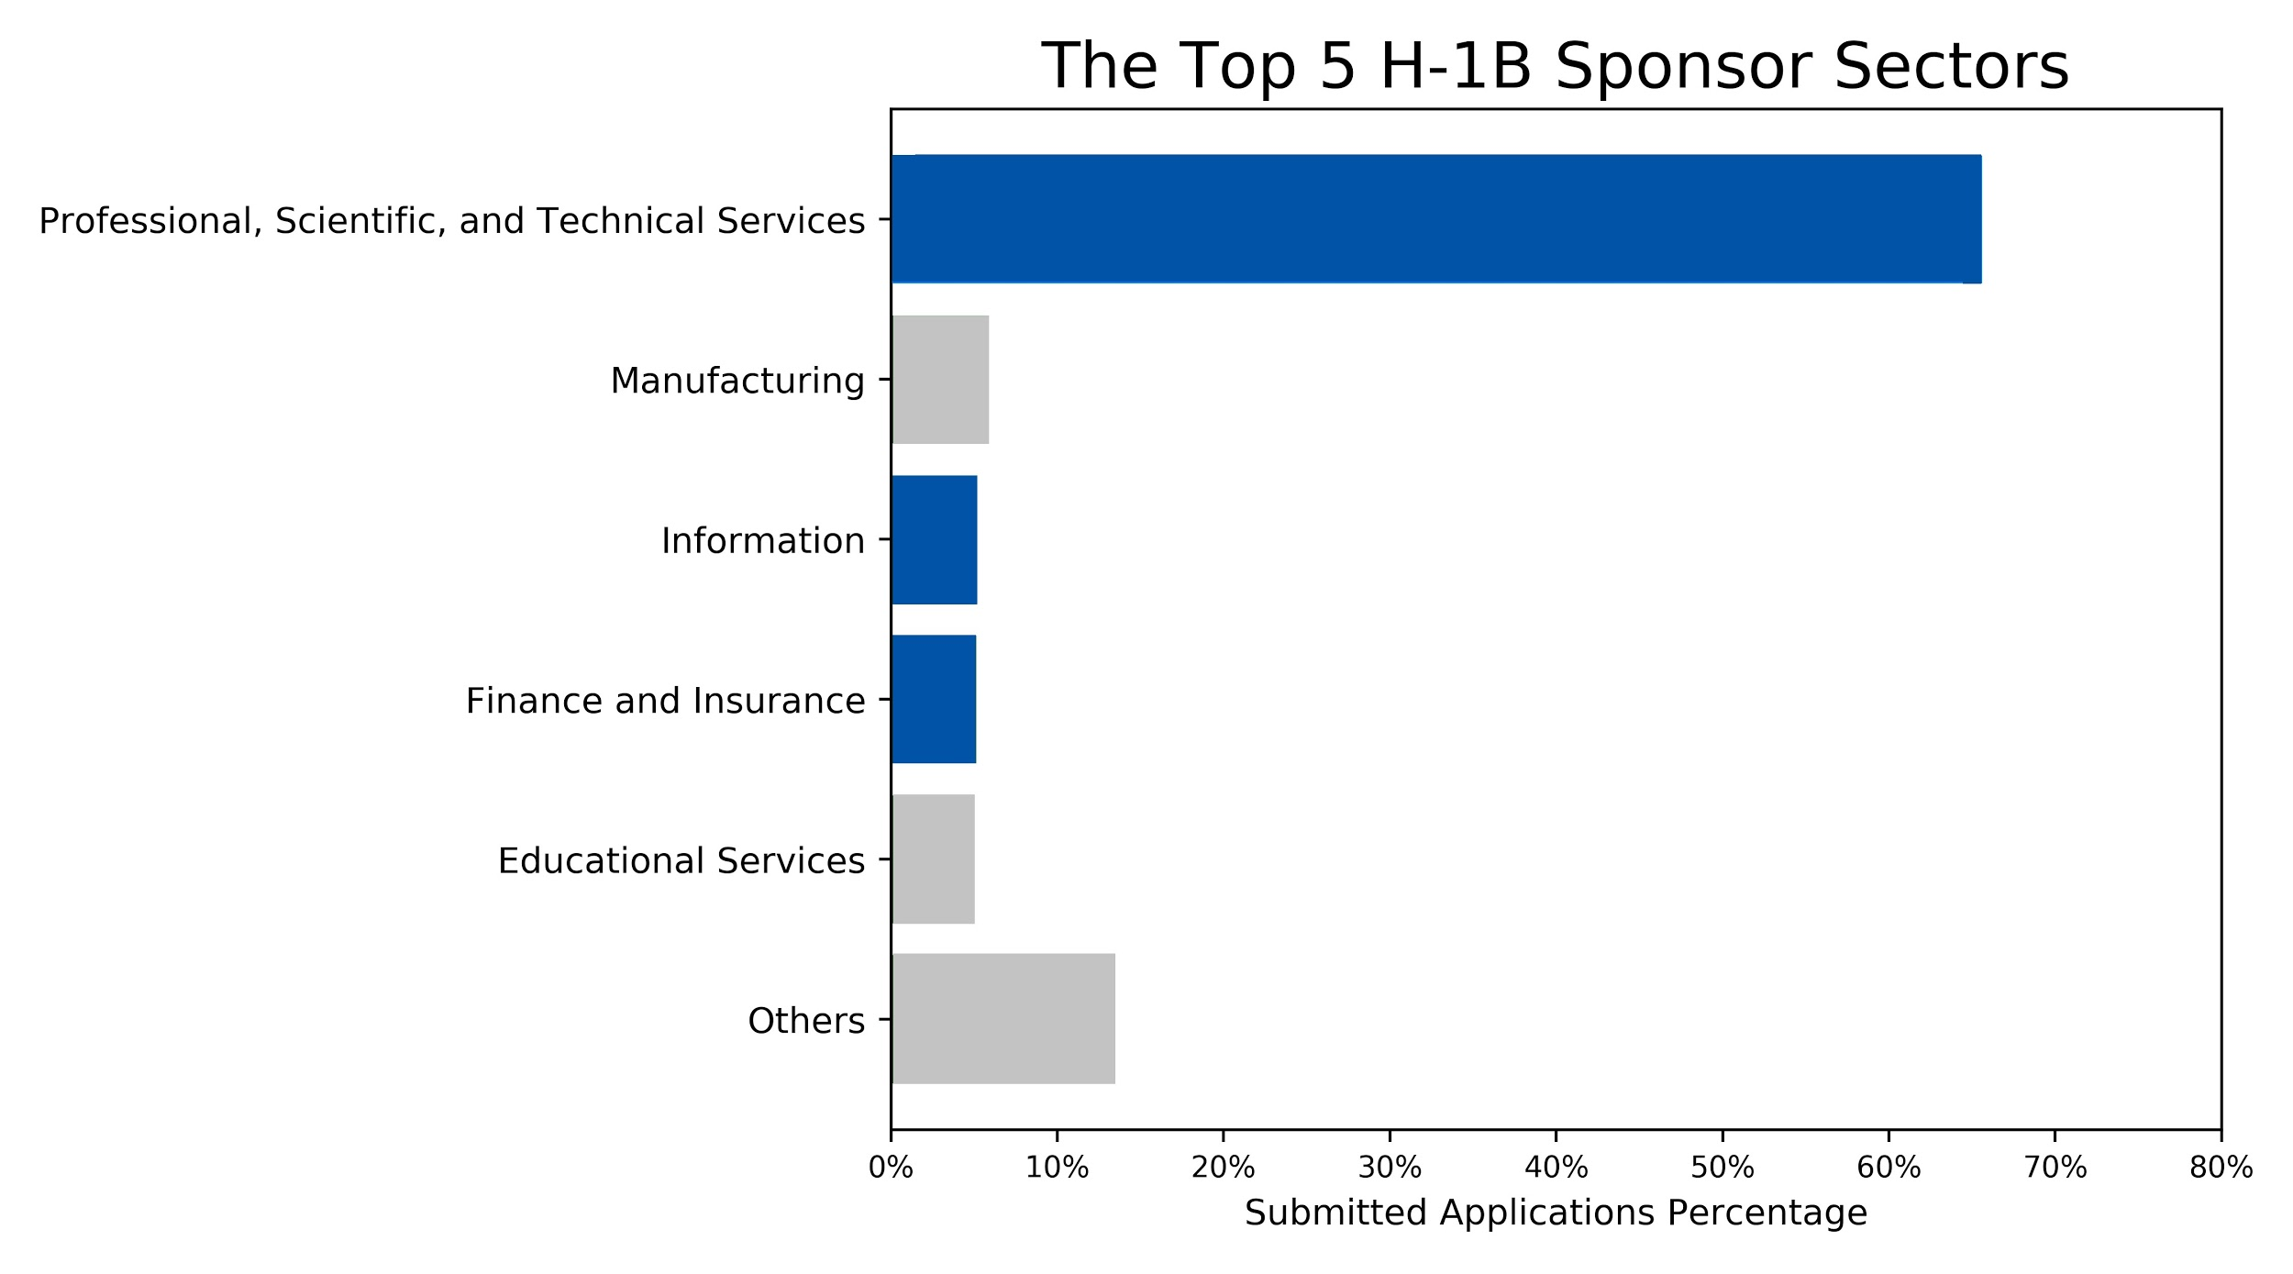
Professional services offer a big pool of opportunity for H-1B application.
Management
Consulting
Marketing
Business research
Notes:
This section provides information relating to employment and unemployment in financial activities. While most data are obtained from employer or establishment surveys, information on industry unemployment comes from a national survey of households. The following tables present an overview of the industry including the number of jobs, the unemployment rate of those previously employed in the industry, job openings and labor turnover, union membership and representation, gross job gains and losses, and projections of occupational employment change.
Finance and Insurance: NAICS 52
Real Estate and Rental and Leasing: NAICS 53

Slide 7
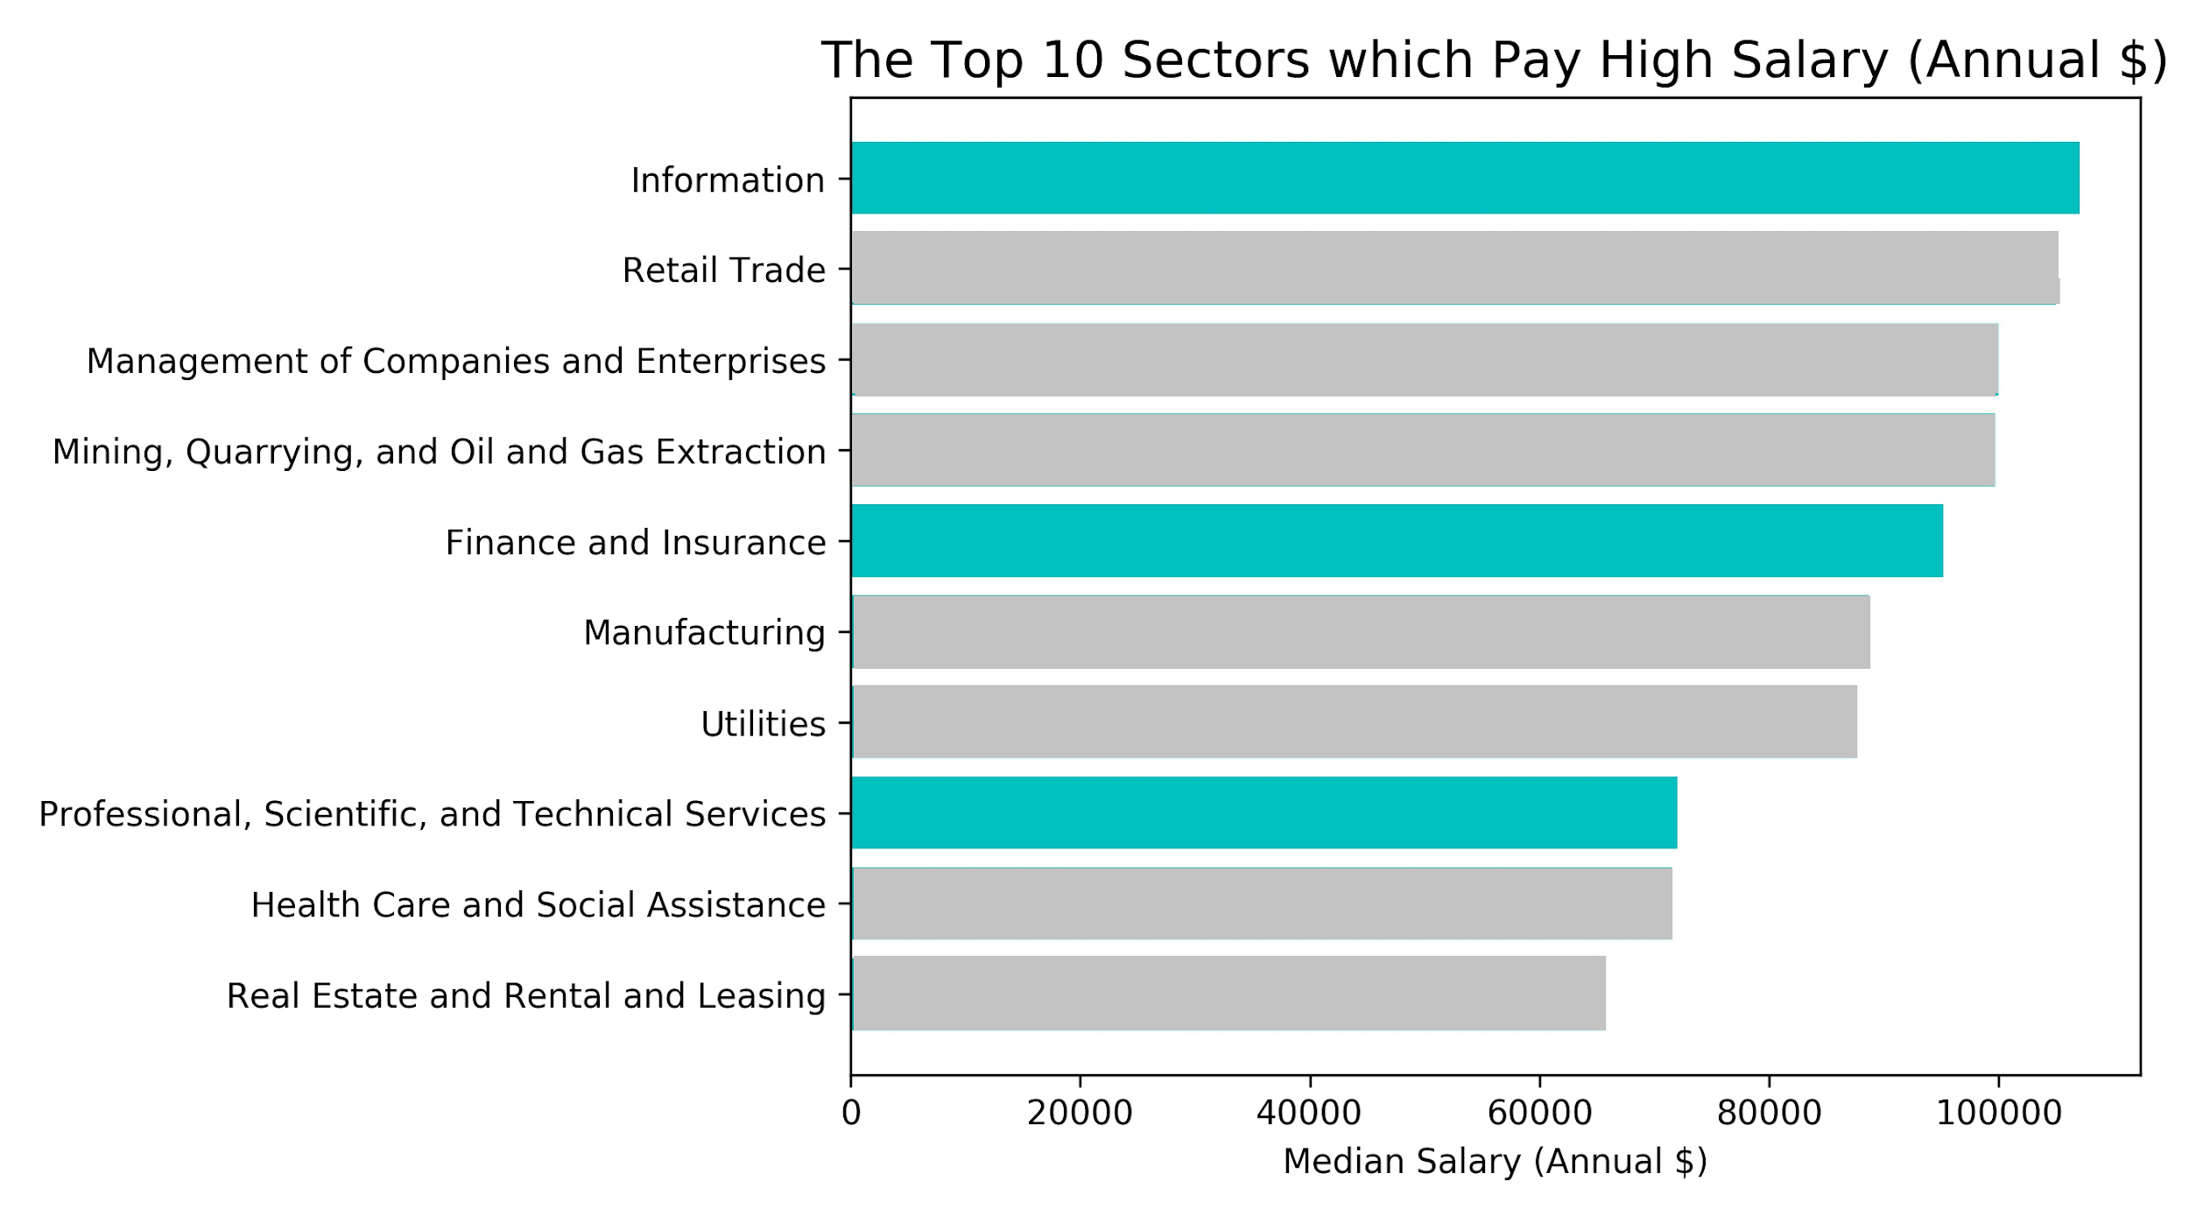
For higher salary, consider information and finance sector
Data Processing
Web hosting
Applications development
Notes:
The Information sector comprises establishments engaged in the following processes: (a) producing and distributing information and cultural products, (b) providing the means to transmit or distribute these products as well as data or communications, and (c) processing data.
Publishing Industries (except Internet): NAICS 511
Motion Picture and Sound Recording Industries: NAICS 512
Broadcasting (except Internet): NAICS 515
Telecommunications: NAICS 517
Data Processing, Hosting, and Related Services: NAICS 518
Other Information Services: NAICS 519

Slide 8
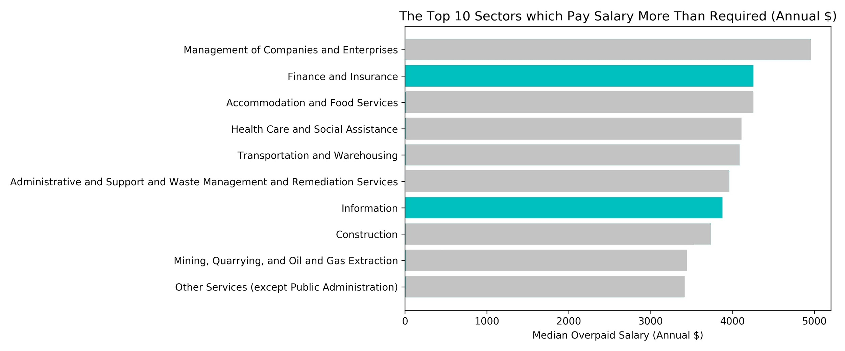
Finance sectors offer higher than average salary
Notes:
This section provides information relating to employment and unemployment in financial activities. While most data are obtained from employer or establishment surveys, information on industry unemployment comes from a national survey of households. The following tables present an overview of the industry including the number of jobs, the unemployment rate of those previously employed in the industry, job openings and labor turnover, union membership and representation, gross job gains and losses, and projections of occupational employment change.
Finance and Insurance: NAICS 52
Real Estate and Rental and Leasing: NAICS 53

Slide 9
Conclusion and recommendation
Location
Salary
Employer
Industry
Notes:
Given the above analysis, we can see that all the factors are important.
For location, If you prefer a place with more job opportunities, coastal areas will definitely be your first choice. Meanwhile, cities like sanfran cisco and Mountain View provides more attracitve salary packages.
As for employers, we can see that over 60% of them are from industries called “professional, scientific and technical service” However, this industry may not be the one that offer the highest salary packages, and they may not be willing to offer more than the government required.
In terms of higher salary, you should consider industries like information and finance and insurance.
Our recommendation is that you should take consideration of all of the above factors and weight the one that you think the most important. As we are student with data anlaytics backrgound, you can utilize your data analytics skill to get the information that is necesaary for you to make decision.
Last but not the least,

Slide 10
Thank You!
Questions ?

